Slide 1
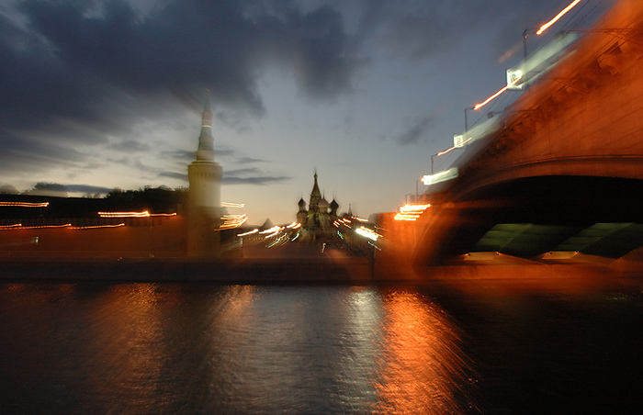
Euro from the Russian Perspective
Olga Butorina
Institute
of Europe
Russian
Academy
of Sciences

Slide 2
Issues to discuss
Partners’ policy goals
Russia at the global FX markets
Euro as an international currency in Russia
Liquidity enigma

Slide 3
Russia’s explicit policy goals
To diversify currency structure of international payments
To decrease country’s dependence on US dollar
To reduce foreign exchange risks

Slide 4
EU implicit policy goals
To make the euro a key international currency
To use euro as an invoice/settlement currency in energy trade
To make euro an attractive foreign currency for non-EU Europe, CIS, Mediterranean region.

Slide 5
Turnover of OTC FX instruments by currency, bln USD, BIS
Shares – 2016
USD – 88%
EUR – 31%
JPY – 22%
GBP – 13%
AUD – 7%
CAD – 5%
CHF – 5%
CNY – 4%
RUB – 1%
PLN – 1%

Slide 6
Turnover of OTC FX instruments by country, BIS
 |  | 1998 |  | 2016
 | Total | 2099 | 100 | 6514 | 100
1 | UK | 685 | 32,6 | 2406 | 36,9
2 | USA | 383 | 18,2 | 1272 | 19,5
3 | Japan | 146 | 7,0 | 399 | 6,1
4 | Singapore | 145 | 6,9 | 517 | 7,9
5 | Switzerland | 92 | 4,4 | 156 | 2,4
6 | Hong Kong | 80 | 3,8 | 437 | 6,7
7 | France | 77 | 3,7 | 181 | 2,8
8 | Australia | 48 | 2,3 | 121 | 1,9
9 | Germany | 100 | 4,8 | 116 | 1,8
10 | Denmark | 28 | 1,3 | 101 | 1,6
 |  | 1998 |  | 2016
 | Total | 2099 | 100 | 6514 | 100
10 | Denmark | 28 | 1,3 | 101 | 1,6
11 | Canada | 38 | 1,8 | 86 | 1,3
12 | Netherlands | 43 | 2,0 | 85 | 1,3
13 | China | 0 | 0,0 | 73 | 1,1
14 | Korea | 4 | 0,2 | 48 | 0,7
15 | Russia | 10 | 0,5 | 45 | 0,7
16 | Sweden | 16 | 0,8 | 42 | 0,6
17 | Norway | 9 | 0,4 | 40 | 0,6
18 | Luxembourg | 23 | 1,1 | 37 | 0,6
19 | India | 2 | 0,1 | 34 | 0,5
29 | Spain | 20 | 1,0 | 22 | 0,3

Slide 7
Functions of the international currency
Functions | Private use | Public use
Means of payments | Vehicle currency, currency substitution | Intervention currency
Unit of account | Invoice currency | Anchor
Store of value | Investment & financing | Official reserves
Krugman, Paul (1991) Currencies and Crises. Cambridge, MA: MIT Press

Slide 8
Preparations and benefits
Bank of Russia 1998: regulations for the use of the euro. Report.
1999 – operations at the MICEX
Transparent prices in the euro area
Lower exchange costs and FX risks (logistics, tourism)

Slide 9
Spreads at the retail FX markets 2001 – 2006, %

Slide 10
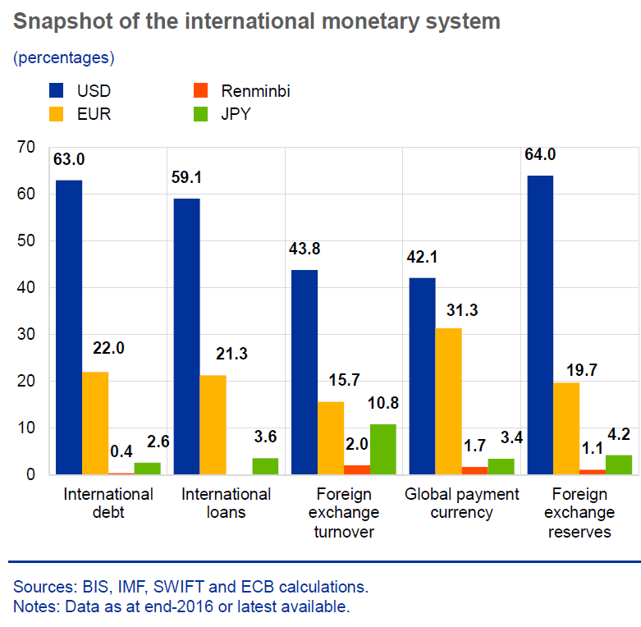
International role of the Euro, ECB-2017
Euro remains second most important currency in international monetary system

Slide 11
Challenges
Dollarization, USD as a unit of account for business and households.
Lack of experience and expertise.
Euro markets are less deep and liquid than dollar markets.

Slide 12
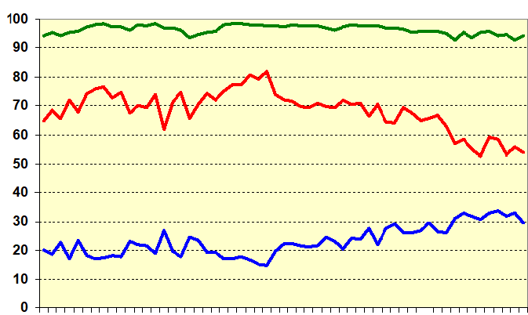
Russian interbank FX market
Dollar
Ruble
Euro
Almost total euro turnover =EUR-USD
operations

Slide 13
Euro as a peg currency in RF
01.02.2005 Bank of Russia: basket of currencies for exchange rate policy 0,1 EUR and 0,9 USD
02.12.2005: 0,4 EUR and 0,6 USD
25.08.2005 – first FX interventions EUR-RUB.
November 2014 – FX margins were eliminated.

Slide 14
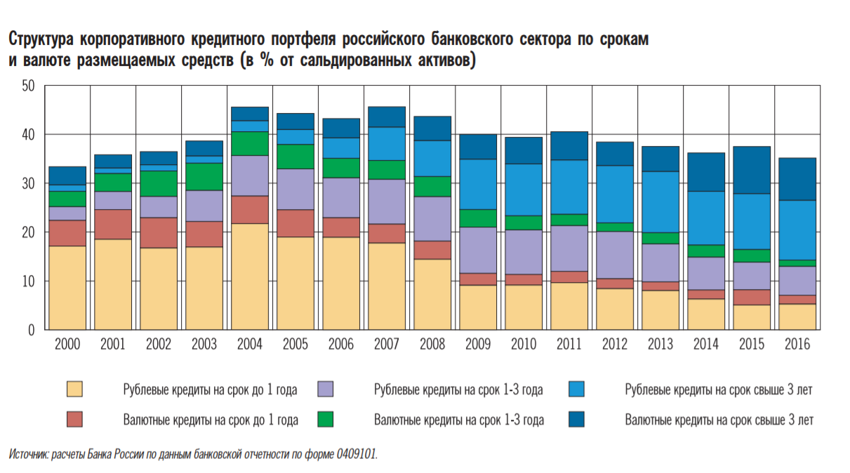
Bank loans to corporate sector

Slide 15
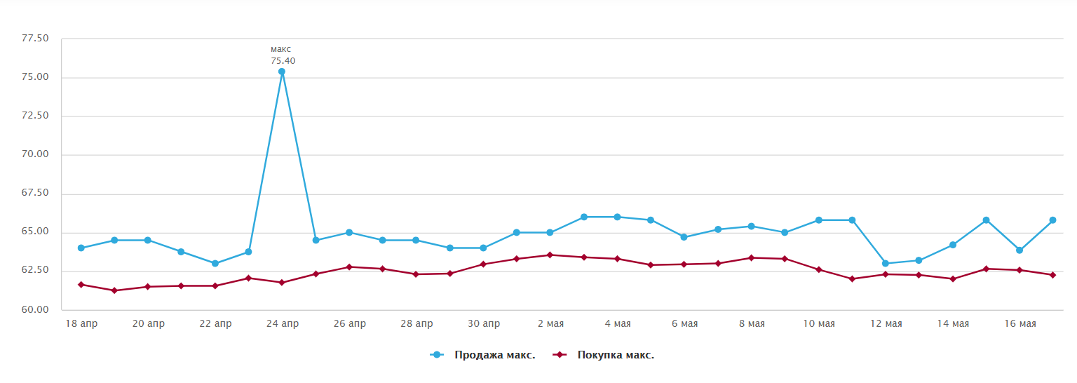
RUB-USD spreads = 1,0 – 1,3
18.04-16.05.2018, RBC

Slide 16
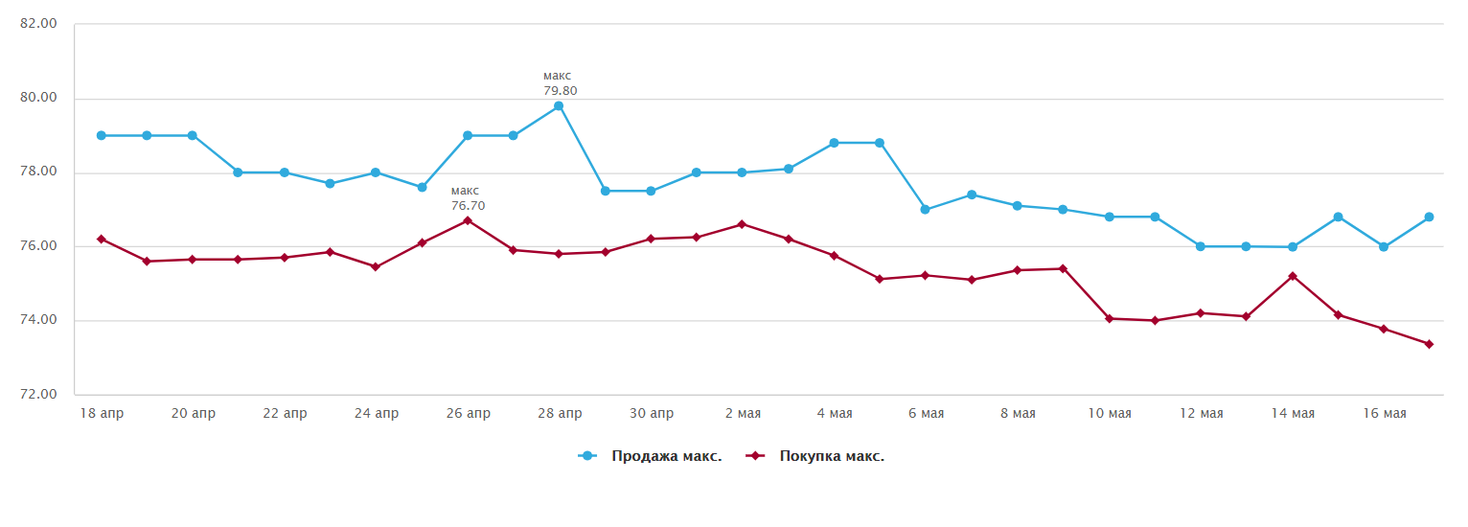
RUB-USD spreads = 1,3 – 1,7
18.04-16.05.2018, RBC

Slide 17
RUB weighted spreads, 16.05.2018 - RBC
EUR | 2,11
USD | 2,28
GBP | 4,92
CHF | 5,36
CAD | 12,73
PLN | 19,77
CNY | 19,94
KZT | 28,48
DKK | 30,68

Slide 18
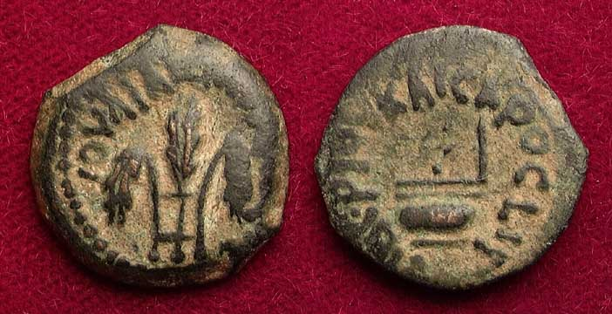
Thank you for the attention!

