Slide 1

“The Russian Economy in the Face of Sanctions: An Analysis of Impacts, Adaptations, and Future Perspectives”
Author:
Domenico Zagarrio
With contributions from:
Prof. Marco Ricceri

Slide 2

OBJECTIVE
To understand how international sanctions have influenced economic dynamics and the position of the Russian Federation in the international context.
FOCUS PRINCIPALE
MAIN FOCUS
The historical vulnerability of the Russian economy to external factors
2014-2024: cycles of sanctions and Russian adaptation responses
UNINT.EU
Università degli Studi Internazionali di Roma – UNINT
Via Cristoforo Colombo 200 | 00147 Roma

Slide 3
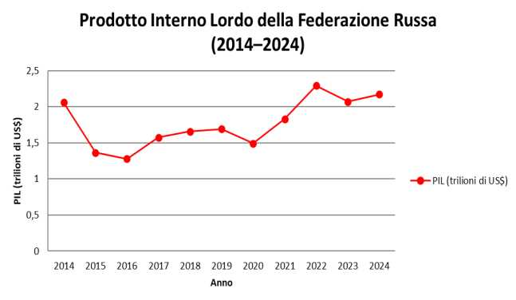
MACROECONOMIC INDICATORS
: 1. GDP AND ECONOMIC GROWTH
2014-2016 ➔ most critical phase of the decade (USD 1.3 trillion)
2020 ➔ collapse in energy prices + Covid-19 pandemic (USD 1.5 trillion)
2022 ➔ GDP reaches its highest level (USD 2.2 trillion)
UNINT.EU
Università degli Studi Internazionali di Roma – UNINT
Via Cristoforo Colombo 200 | 00147 Roma

Slide 4
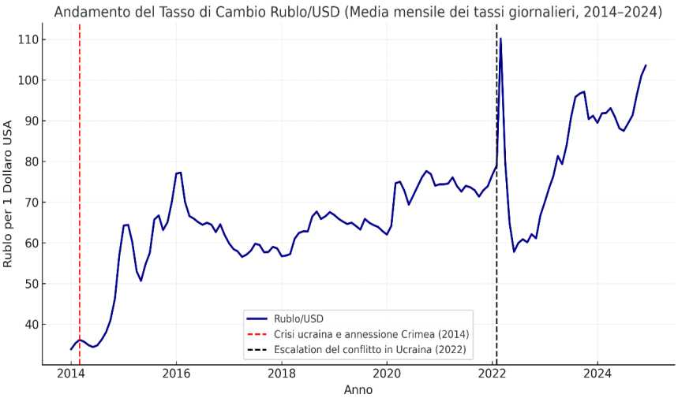
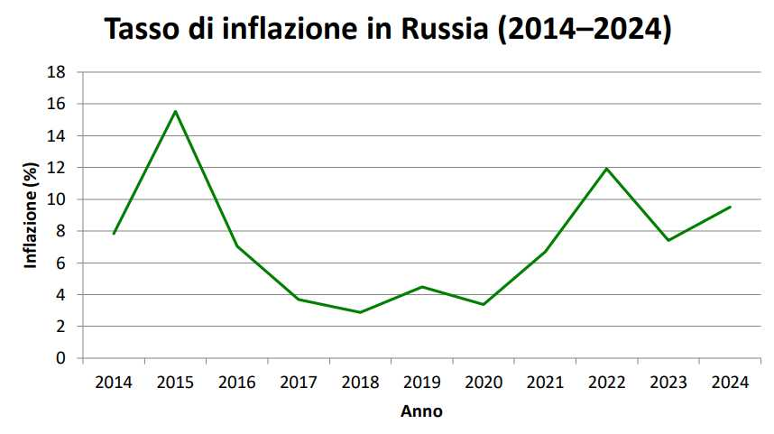
2.1 EXCHANGE RATE 2.2 INFLATION RATE
2014-2016: sharp increase in the ruble–dollar exchange rate ➔ runaway inflation
2017-2021: gradual stabilization
dal 2022: most critical period ➔ strong ruble depreciation and rising inflation
UNINT.EU
Università degli Studi Internazionali di Roma – UNINT
Via Cristoforo Colombo 200 | 00147 Roma

Slide 5
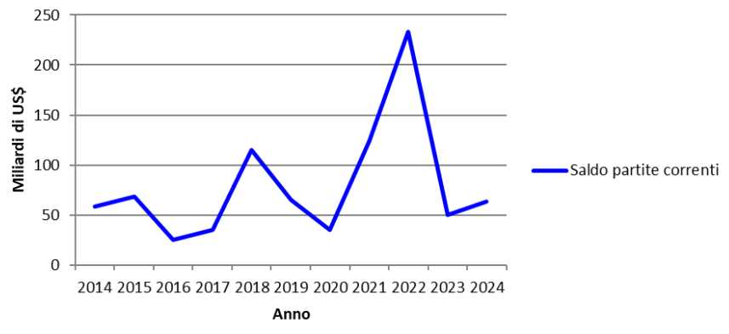
3. CURRENT ACCOUNT BALANCE
2022: record surplus of over USD 230 billion
Surge in energy prices
Sharp reduction in imports
Return to pre-sanctions levels from 2023
UNINT.EU
Università degli Studi Internazionali di Roma – UNINT
Via Cristoforo Colombo 200 | 00147 Roma

Slide 6
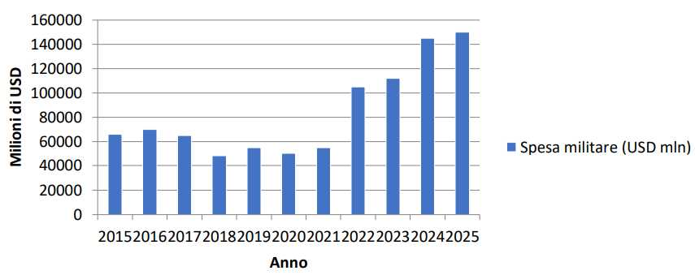
RESILIENCE POLICIES:
1. DEFENSE AS AN ECONOMIC DRIVER
Economic stabilization
From 2022: over 6% of GDP
Possible crowding-out effect on investments
UNINT.EU
Università degli Studi Internazionali di Roma – UNINT
Via Cristoforo Colombo 200 | 00147 Roma

Slide 7
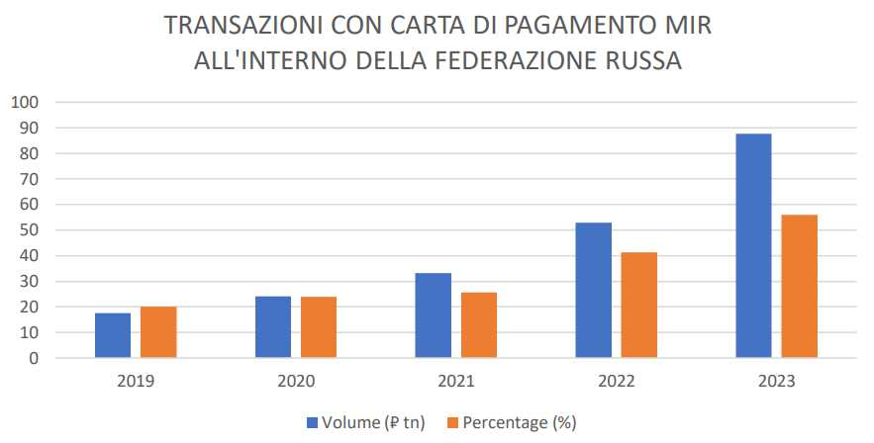
2. THE MIR PAYMENT SYSTEM
Targeted government interventions:
a) Incentives
b) Mandatory acceptance requirements
c) Promotional campaigns
d) MIR as the main payment network for pensions and public-sector salaries
Financial sovereignty
Suspension of Mastercard and Visa operations in the Russian Federation ➔ strengthening of the MIR system
2023: more than half of domestic transactions processed via MIR
UNINT.EU
Università degli Studi Internazionali di Roma – UNINT
Via Cristoforo Colombo 200 | 00147 Roma

Slide 8
3. PARALLEL IMPORTS 4. INVESTMENT IN STATE-OWNED
ENTERPRISES
Central role in the national economy
Stable revenues, production growth, and employment
Gazprom (gas sector), Rosneft (leading oil company), and Rostec (industrial conglomerate) ➔ record significant profits
Negative impact on private firms ➔ more vulnerable to the loss of Western partners and investors
2022, Government Decree No. 506
Allows the continuity of goods and services’ supplies through third countries without the authorization of the trademark owner
UNINT.EU
Università degli Studi Internazionali di Roma – UNINT
Via Cristoforo Colombo 200 | 00147 Roma

Slide 9
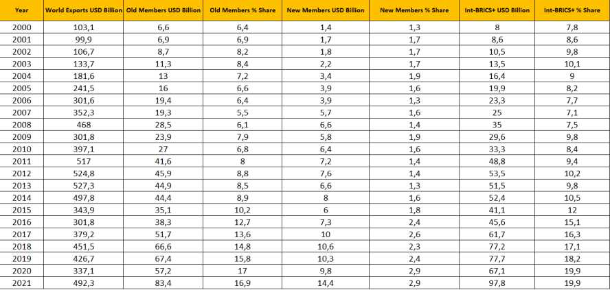
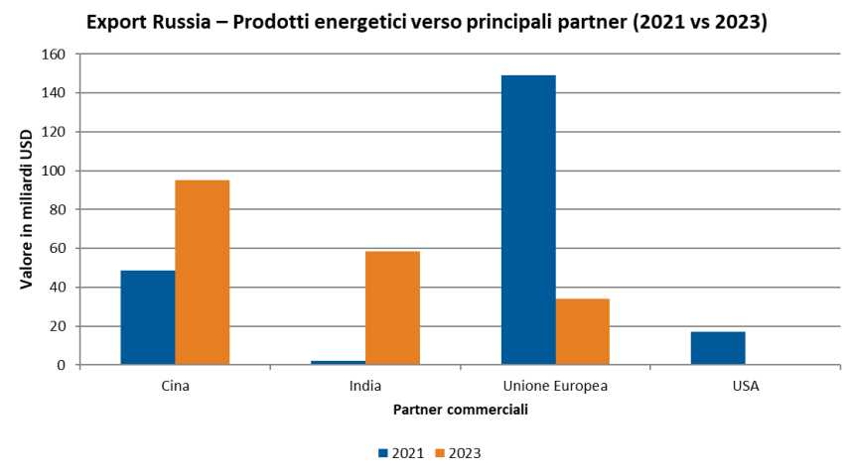
5. GEOPOLITICAL AND TRADE REORIENTATION TOWARD THE BRICS
Decline in trade with Western economies ➔ strengthening of commercial ties with BRICS countries
2021-2023: China and India emerge as the main trading partners
Reduces economic isolation by opening new export opportunities, while increasing geopolitical dependence
UNINT.EU
Università degli Studi Internazionali di Roma – UNINT
Via Cristoforo Colombo 200 | 00147 Roma

Slide 10
CONCLUSIONS
International sanctions ➔ internal and external transformation
The Russian economic system ➔ resilient, but not structurally transformed
Russia’s future challenges:
Transition from defensive resilience to evolutionary resilience.
Diversification, technological innovation, and international cooperation.
UNINT.EU
Università degli Studi Internazionali di Roma – UNINT
Via Cristoforo Colombo 200 | 00147 Roma

Slide 11
“The Russian Economy in the Face of Sanctions: An Analysis of Impacts, Adaptations, and Future Perspectives”
THANK YOU FOR YOUR ATTENTION
Author:
Domenico Zagarrio
With contributions from:
Prof. Marco Ricceri

