Slide 1
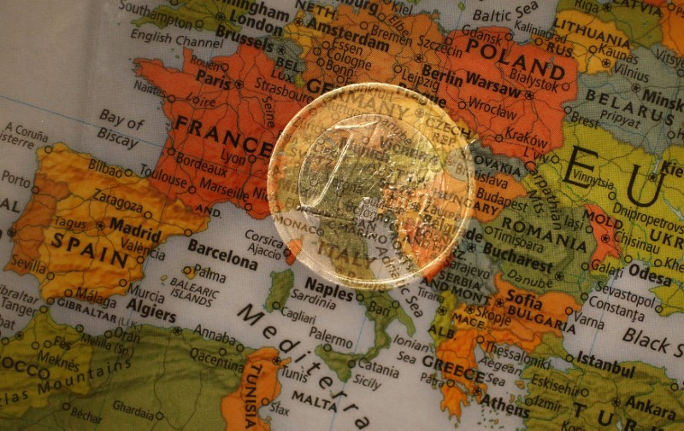
An Economic History of the Euro
Olga Butorina
Presentation at the EU Delegation
in Russia
22/01/2020

Slide 2
Contents
Bretton Woods and after.
“Snake” and the EMS.
From the four freedoms to the single currency.
The true value of euro.

Slide 3
Postwar global money
Fixed exchange rates.
Option 1: Fiat (paper) money with the single emission center. Keynes – International Clearing Union.
Option 2: Gold-exchange standard where USD is convertible into gold and other currencies have fixed rates to the USD.

Slide 4
Gold reserves of central banks and governments, USD mln.

Slide 5
The Bretton Woods trick
July 1944.
Axis and neutral countries did not participate.
All European countries except UK and Iceland were occupied.
China and the USSR – useful deadweight.

Slide 6
European Payments Union
1950 – 1958
Restored convertibility, multilateral settlements instead of barter.
Moneys of different quality. European currencies – trade within the EEC.
USD – international trade and investments, prices for oil and commodities.

Slide 7
Nominal effective exchange rates 1964=100, BIS

Slide 8
Why the EEC needed fixed rates?
Rome treaty – little attention to monetary cooperation. “Hamlet” without the Prince of Denmark.
Common Agricultural Policy – an island of planned economy in the free markets sea. A strategic deal between France and Germany.
Flexible exchange rates exchange rates - a threat to trade flows? Real risk of rising protectionism and dollarization.

Slide 9
European monetary cooperation
“Snake in the tunnel” (1972-1978) gave limited results.
European Monetary System and the Exchange Rate Mechanism (ERM).
Three challenges: removal of capital controls (1992), rapid growth of financial markets, Germany’s unification.

Slide 10
Daily foreign exchange turnover (BIS), GDP and exports.
Daily foreign exchange turnover:
2010 – $3.7 trillion
2013 – $4.9 trillion
2016 – $5.1 trillion
2019 - $6.6 trillion

Slide 11
Why the European central bank?
Tommaso Padoa-Schioppa (1940-2010), an Italian banker and economist.
EU national central banks need to coordinate their interest rates.

Slide 13
The true value of the euro
The euro reduces the actual discrimination of the EU in the global economy and prevents the dollarization of domestic payments.
It safeguards the EU internal market from the rise of protectionism.
The EMU allowed the EU to keep a historical initiative after the collapse of the bipolar system.
Now it is a tool for global governance.

Slide 14
Thank you for the attention!

