Slide 1
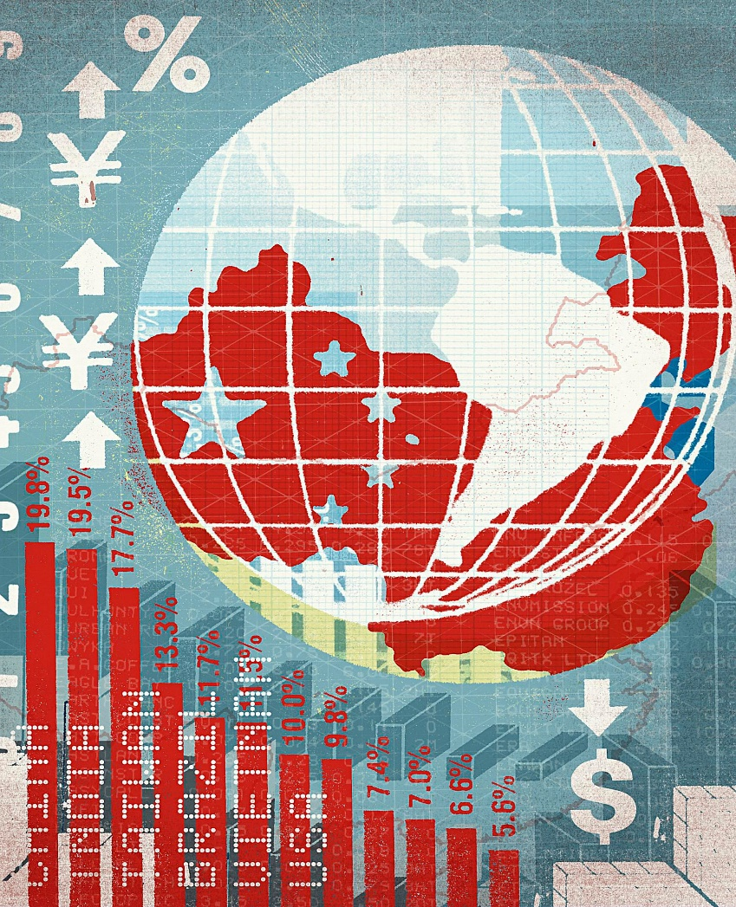
Global trade imbalances, exchange rates and currency internationalization
Olga Butorina,
XVIII International Conference “Evolution of the International Trading System: Problems and Prospects”
St Petersburg University, April 15, 2021

Slide 2
Issues to discuss
Are there blank spots in the economic theory?
Do exchange rates depend on the international role of a currency?
If some currencies are more equal than others, how it effects global trade?

Slide 3
Some implicit assumptions
Mundell–Fleming model assumes that the relationship between the nominal exchange rate and the interest rate is similar for any small open economy.
The theory of the optimum currency area says nothing about third economies and their currencies.

Slide 4
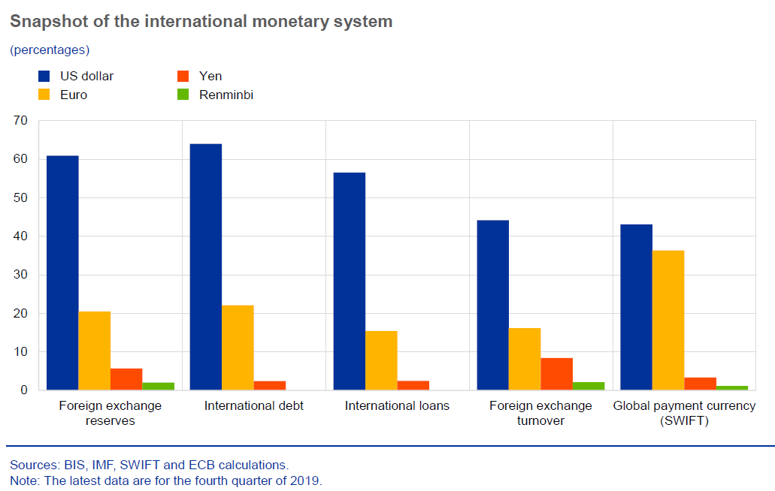
U.S. dollar’s exorbitant privilege
Source: ECB. The international role of the euro, June 2020.

Slide 5
Faces of currency asymmetry
Bundesbank’s problems with outflows and especially inflows of capital during the ERM period.
Emerging economies’ “original sin” and financial crises.
Trade and current account imbalances should be viewed through the lenses of invoicing traditions and corporate footprint.

Slide 6
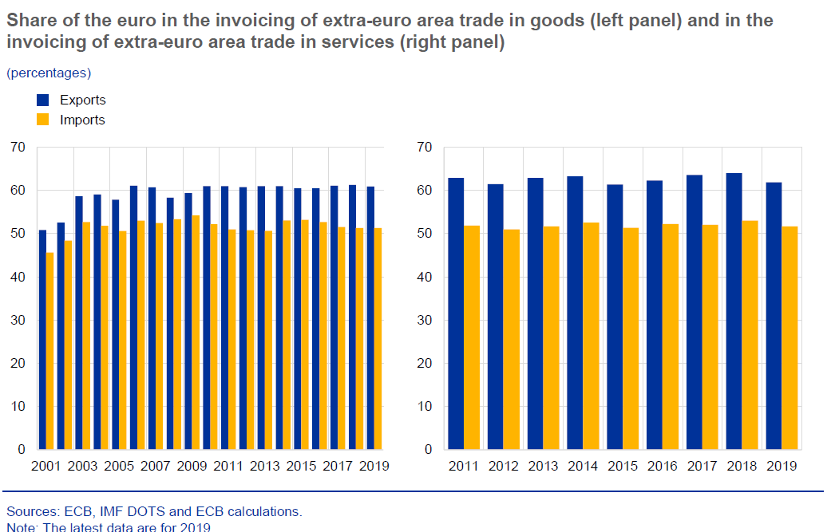

Slide 7
Academic discussion
Emerging countries face a dilemma not trilemma since the U.S. dollar fluctuations affect strongly their exchange rates and interest rate policy (1,2).
The role of the exchange rate as a shock absorber largely depends on the export pricing paradigm (3).
While invoicing practices are not effected by the obstacles to the use of the euro (4).
Current accounts within currency zones are close to balance (5).

Slide 8
Conclusions
Exchange rate movements are not indifferent to the global status of a currency (dominant, key, international, domestic).
Floating exchange rates act differently as automatic stabilizers in countries with a dominant, key or a domestic currency.
The global currency hierarchy proves to be stable and self-replicating (e.g. through trade and FX vehicle) contributing to the persistence of global trade imbalances.

Slide 9
Selected literature
1) Rey H. (2018). Dilemma not Trilemma: The Global Financial Cycle and Monetary Policy Independence. NBER Working Paper No. 21162. May 2015, Revised February 2018.
2) Nelson E. (2020). The Continuing Validity of Monetary Policy Autonomy under Floating Exchange Rates. International Journal of Central Banking, Vol. 16, No 2, pp. 81-123.
3) Georgiadis G., Schumann B. (2019). Dominant-currency pricing and the global output spillovers from US dollar appreciation. ECB Working Paper Series No 2308.
4) Langedijk S., Karagiannis S., Papanagiotou E. (2016). Invoicing Currencies in International Trade - Drivers and Obstacles to the Use of the Euro. European Commission. JRS Science for Policy Report.
5) Ito H., McCauley R. (2018). A key currency view of global imbalances. BIS Working Papers, No 762.

Slide 10
Further reading
Anthony M. Endres (2017). Doctrinal Developments in International Money: The Question of Currency Internationalization from Bretton Woods to the 1970s. Journal of the History of Economic Thought, Vol. 39, No. 4, pp. 429-451.
Pierre-Olivier Gourinchas, Helene Rey, Maxime Sauzet (2019). The International Monetary and Financial System. NBER Working Paper No. 25782.
Barbara Fritz, Luiz F. de Paula, Daniela Magalhães Prates (2018). Global currency hierarchy and national policy space: a framework for peripheral economies. European Journal of Economics and Economic Policies: Intervention, Vol. 15 No. 2, 2018, pp. 208–218.

Slide 11
Thank you for
the attention!

